Slide 1
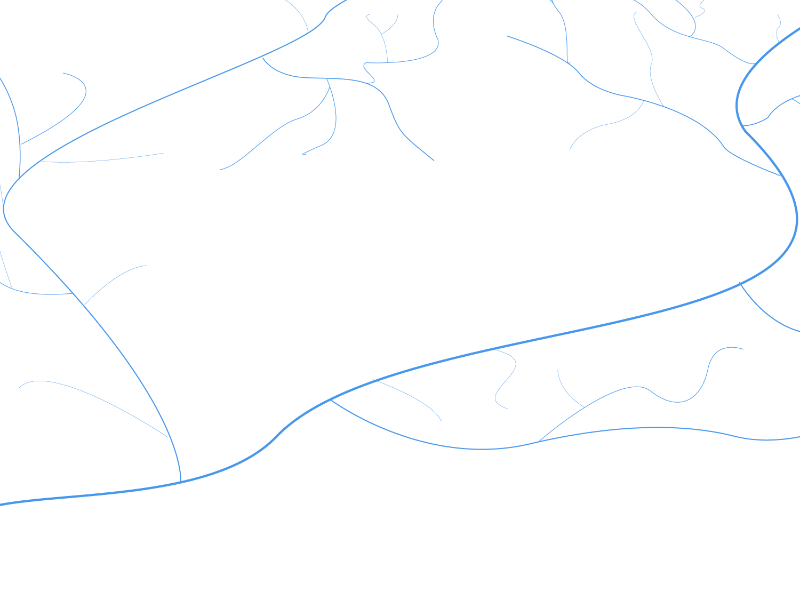


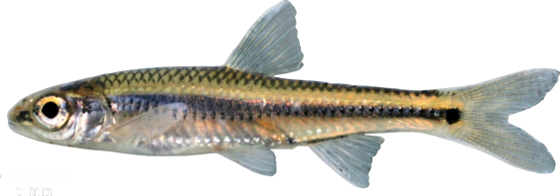


CSP4141 ~ Occupancy Modeling
Nuts & Bolts ~ Single-Season Occupancy

Slide 2
What is Occupancy?
Generally defined as:
The proportion or percentage of locations where a species is present
The probability that a species is present in a given location
Uses for Occupancy
Distribution
Habitat/resource use
Metapopulation dynamics
Biodiversity (species richness)

Slide 3

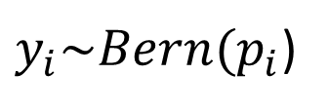
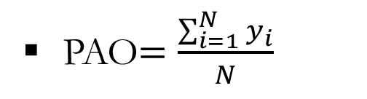
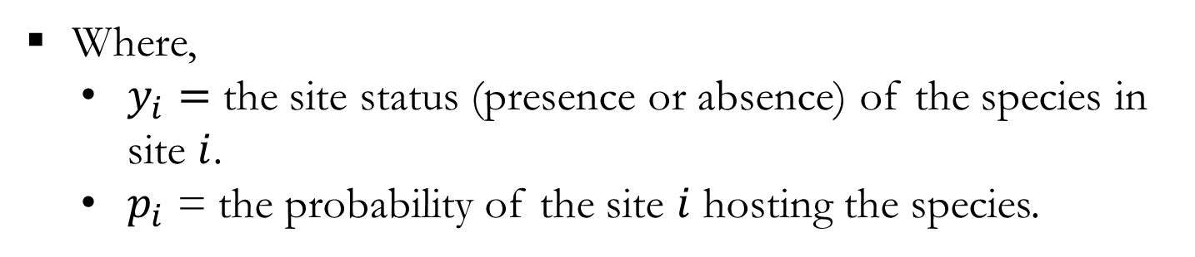
In a Perfect World…
If we could observe all species without error, we could use our observations of occurrence directly in modeling.
Recall the logistic regression model:
$y_{i}\sim Bern(p_{i}$)
$$ln({\frac{p_{i}}{1−p_{i}})=β_{0}+β_{1}∗x_{1_{i}}}$$
Where,
$y_{i}=$ the site status (presence or absence) of the species in site $i$.
$p_{i}$ = the probability of the site $i$ hosting the species.
PAO$=\frac{\sum_{i=1}^{N}{y_{i}}}{N}$
, where PAO = proportion of area occupied and N is the total number of sites

Slide 4
In the Real World…
Observing species presences across sites = detections across sites
Species could easily have been missed at some sites.
If detected, then species presence is certain (unless it’s misidentified)
If not detected, then the species is either:
Truly absent
or…
Present but missed

Slide 5
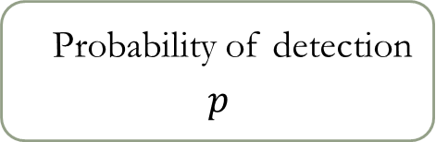
Determining Species Occurrence
Detecting a species in a sample unit depends on 2 factors:
the species must be present
At least 1 individual must be captured
Probability of detection
$$p$$
Capture probability
(the ability to capture an individual)
Abundance
(number of chances)

Slide 6
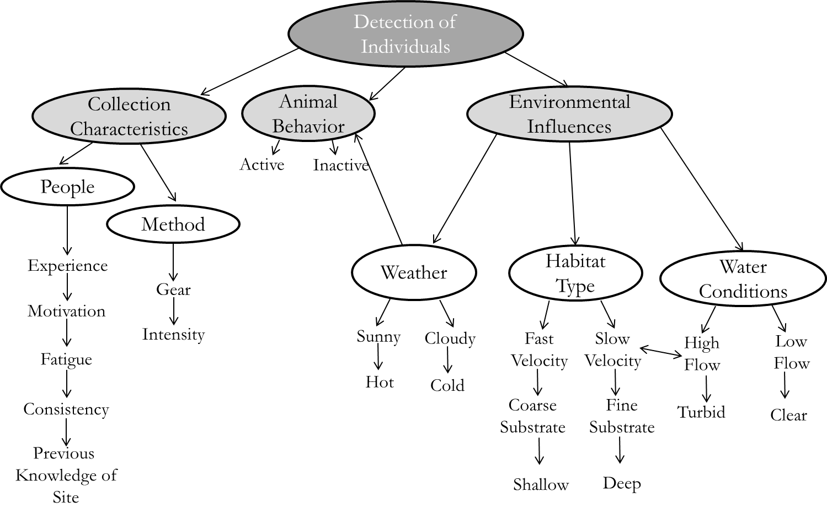
Factors Influencing Detection

Slide 7
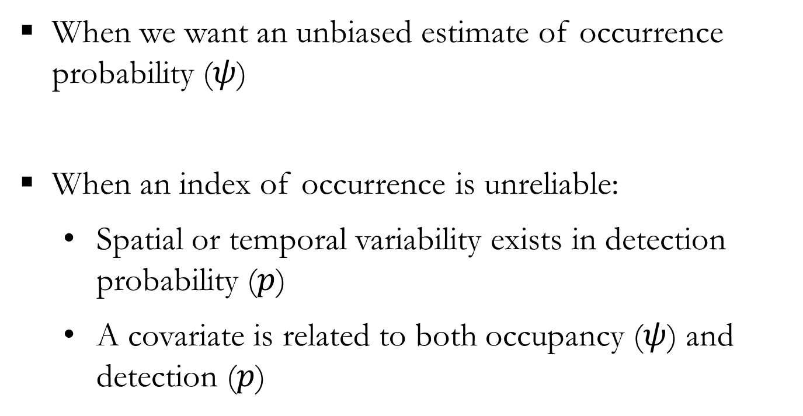
Occupancy Estimation
When Does (Incomplete) Detection Matter?
When we want an unbiased estimate of occurrence probability ($ψ$)
When an index of occurrence is unreliable:
Spatial or temporal variability exists in detection probability ($p$)
A covariate is related to both occupancy ($ψ$) and detection ($p$)

Slide 8
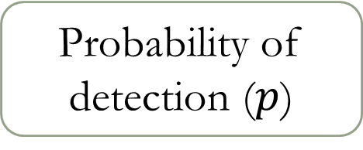


Occupancy Estimation
True species occupancy ($ψ$)
Probability of detection ($p$)
Observed Data
$$y$$

Slide 9
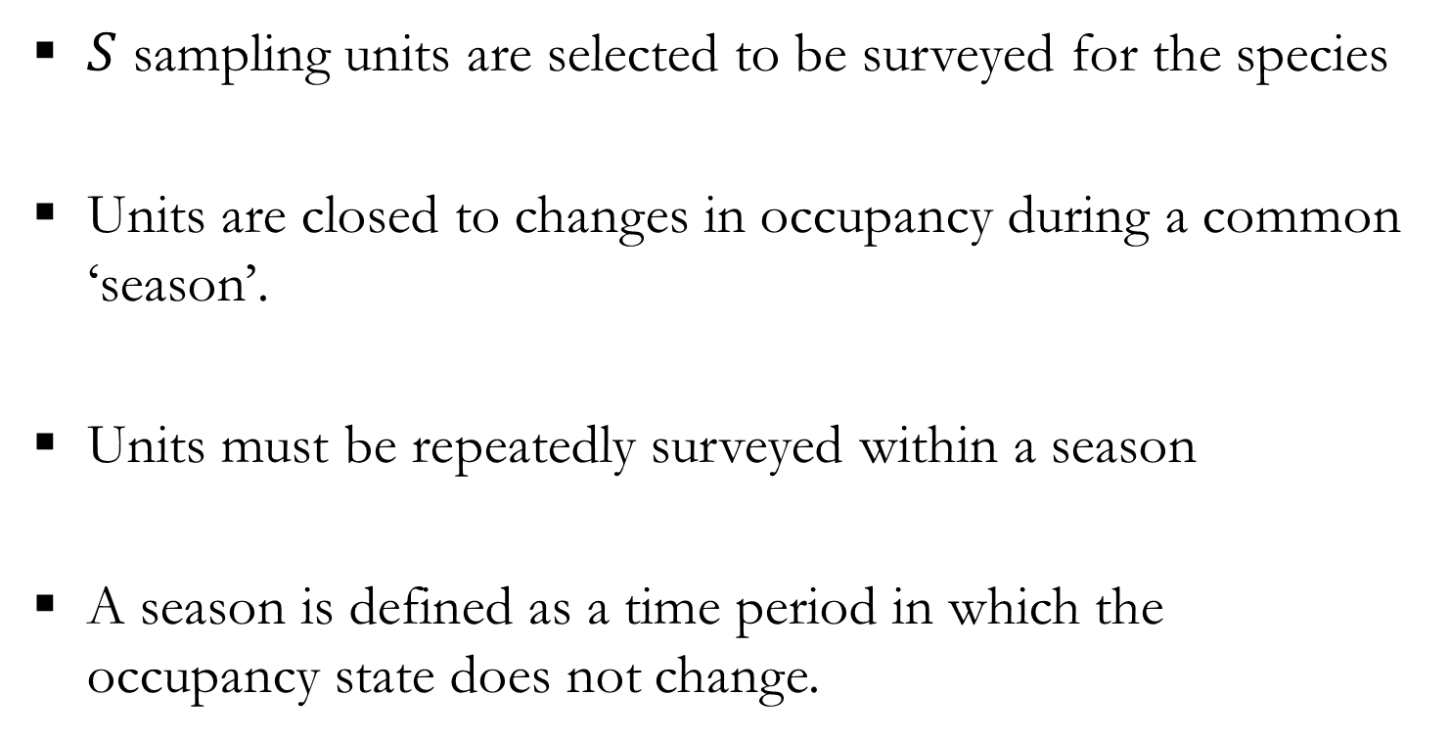
Occupancy Estimation
Basic Sample Design
$S$ sampling units are selected to be surveyed for the species
Units are closed to changes in occupancy during a common ‘season’.
Units must be repeatedly surveyed within a season
A season is defined as a time period in which the occupancy state does not change.

Slide 10
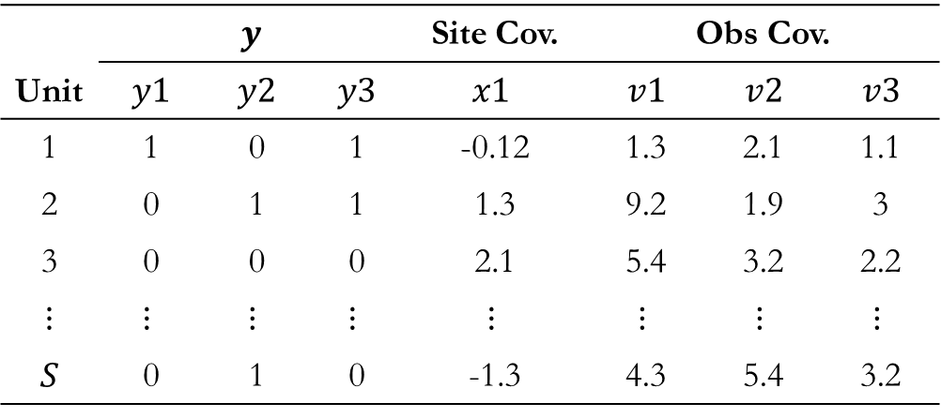
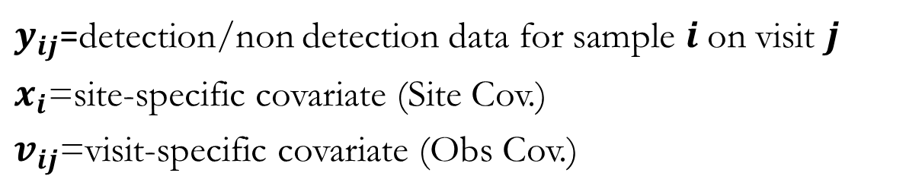
Occupancy Estimation
Data Format
$y_{ij}$=detection/non detection data for sample $i$on visit $j$
$x_{i}$=site-specific covariate (Site Cov.)
$v_{ij}$=visit-specific covariate (Obs Cov.)
Typical Data Collection Structure
Unit | $$y$$ |  |  | Site Cov. | Obs Cov.
 | $$y1$$ | $$y2$$ | $$y3$$ | $$x1$$ | $$v1$$ | $$v2$$ | $$v3$$
1 | 1 | 0 | 1 | -0.12 | 1.3 | 2.1 | 1.1
2 | 0 | 1 | 1 | 1.3 | 9.2 | 1.9 | 3
3 | 0 | 0 | 0 | 2.1 | 5.4 | 3.2 | 2.2
$$⋮$$ | $$⋮$$ | $$⋮$$ | $$⋮$$ | $$⋮$$ | $$⋮$$ | $$⋮$$ | $$⋮$$
$$S$$ | 0 | 1 | 0 | -1.3 | 4.3 | 5.4 | 3.2
3 Sampling occasions

Slide 11
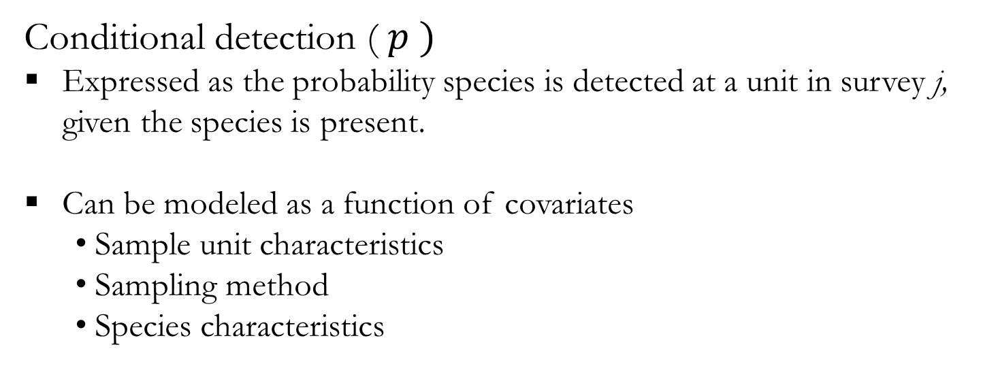
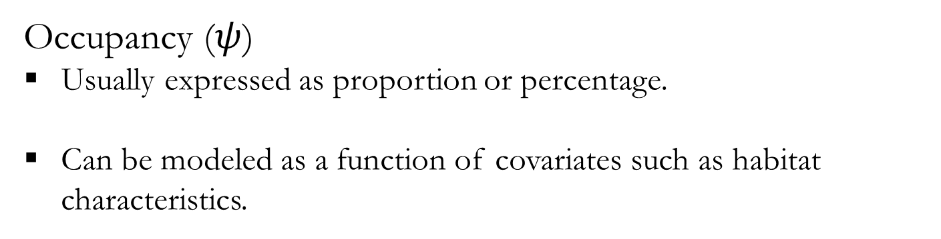
Occupancy Estimation
Occupancy ($ψ$)
Usually expressed as proportion or percentage.
Can be modeled as a function of covariates such as habitat characteristics.
Conditional detection ( $p )$
Expressed as the probability species is detected at a unit in survey j, given the species is present.
Can be modeled as a function of covariates
Sample unit characteristics
Sampling method
Species characteristics

Slide 12
Single Season Model
“detection history”
For example,
Verbal description: species is present at the unit, was detected in first and third survey, not detected in second survey
Mathematical translation:

Slide 13
Single Season Model
“detection history”
For example,
Verbal description: species is present at the unit and was never detected, OR the species is truly absent
Mathematical translation:

Slide 14
Single Season Model
Multinomial Likelihood Approach (MARK and PRESENCE)
Model likelihood is the product of the probability statements.
Where U is the number of sites (observed detection histories)
Multinomial likelihood can be maximized to obtain MLE’s and standard errors (MARK and PRESENCE).

Slide 15
Hierarchical Single season occupancy model
Binomial Likelihood Approach (Hierarchical Representation)
Unmarked fits the standard occupancy model based on zero-inflated binomial models (MacKenzie et al. 2006, Royle and Dorazio 2008).
The occupancy state (z_{i} ) process of site i is modeled as:
z_{i} ∼ Bernoulli(ψ_{i})
The observation (y_{ij} ) process is modeled as:
y_{ij} |z_{i} ∼ Bernoulli(z_{i*}p_{ij} )

Slide 16
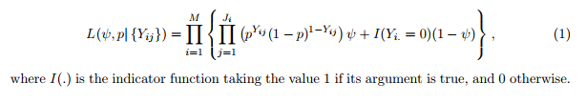
Hierarchical Single season occupancy model
Hierarchical Representation
The occupancy state (z_{i} ) process of site i is modeled as:
z_{i} ∼ Bernoulli(ψ_{i})
The observation (y_{ij} ) process is modeled as:
y_{ij} |z_{i} ∼ Bernoulli(z_{i*}p_{ij} )
Site x occasion-specific observations (1 or 0)
Total number of sites
Total number of occasions

Slide 17
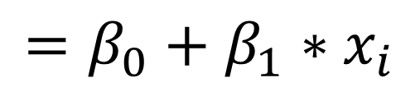
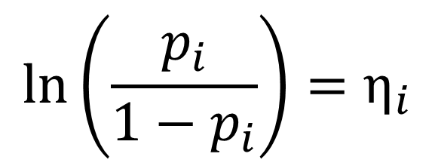
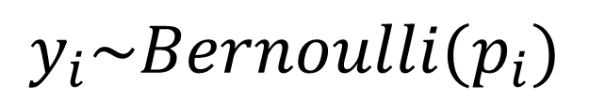
Hierarchical Single season occupancy model
Recall the logistic regression model:
$$\left(\begin{matrix}\begin{matrix}1 \\ 0 \\ 1\end{matrix} \\ \begin{matrix}0 \\ 0 \\ ⋮\end{matrix}\end{matrix}\right)$$
Statistical Distribution
$$y$$
$$=$$
$$y_{i}\sim Bernoulli(p_{i})$$
$${\ln\left(\frac{p_{i}}{1−p_{i}}\right)=η}_{i}$$
$$=β_{0}+β_{1}∗x_{i}$$
Link Function
Linear Predictor

Slide 18
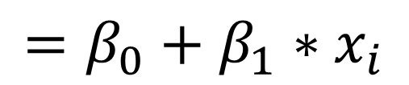

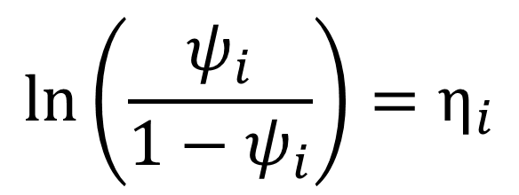
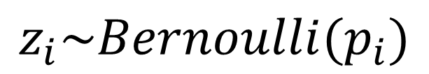

Hierarchical Single season occupancy model
We can adapt this model for the partially observable (latent) occupancy state, z.
$$\left(\begin{matrix}\begin{matrix}1 \\ ? \\ 1\end{matrix} \\ \begin{matrix}? \\ ? \\ ⋮\end{matrix}\end{matrix}\right)$$
Statistical Distribution
$$z$$
$$=$$
$$z_{i}\sim Bernoulli(p_{i})$$
$${\ln\left(\frac{ψ_{i}}{1−ψ_{i}}\right)=η}_{i}$$
$$=β_{0}+β_{1}∗x_{i}$$
Link Function
Linear Predictor

Slide 19
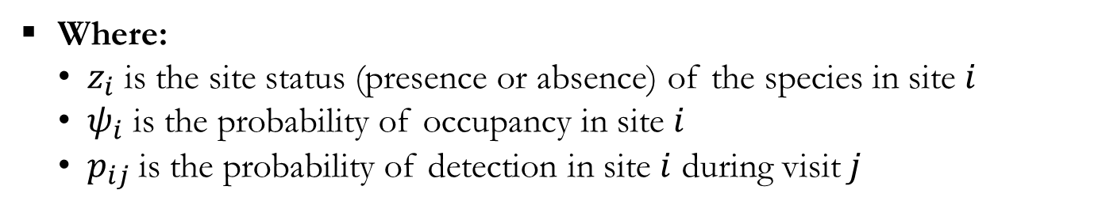

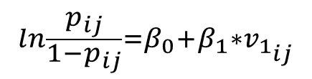
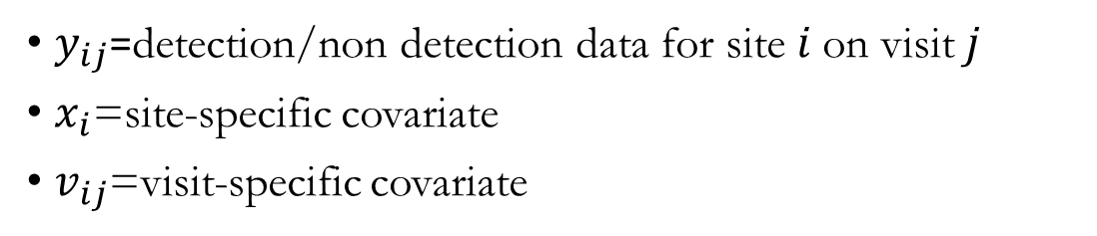

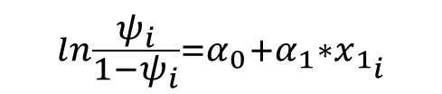


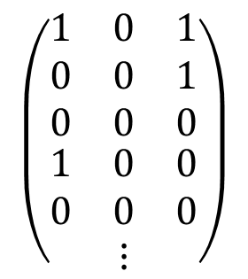
Hierarchical Single season occupancy model
Data ($Y$)
$$\left(\begin{matrix}\begin{matrix}\begin{matrix}1 & 0 & 1\end{matrix} \\ \begin{matrix}0 & 0 & 1\end{matrix} \\ \begin{matrix}0 & 0 & 0\end{matrix}\end{matrix} \\ \begin{matrix}\begin{matrix}1 & 0 & 0\end{matrix} \\ \begin{matrix}0 & 0 & 0\end{matrix} \\ ⋮\end{matrix}\end{matrix}\right)$$
$y_{ij}$=detection/non detection data for site $i$on visit $j$
$x_{i}$=site-specific covariate
$v_{ij}$=visit-specific covariate
$$y_{ij}=$$
Model
State process
(i.e., true site status [latent])
Observation process
(i.e., what is observed)
$z_{i}\sim Bernoulli(ψ_{i}$)
$y_{ij}\sim Bernoulli(p_{ij}×z_{i}$)
$$\ln{\frac{ψ_{i}}{1−ψ_{i}}=α_{0}+α_{1}∗x_{1_{i}}}$$
$$\ln{\frac{p_{ij}}{1−p_{ij}}=β_{0}+β_{1}∗v_{1_{ij}}}$$
Where:
$z_{i}$ is the site status (presence or absence) of the species in site $i$
$ψ_{i}$ is the probability of occupancy in site $i$
$p_{ij}$is the probability of detection in site $i$ during visit $j$

Slide 20
Single Season Model: Site-Level Covariates
Site-specific covariates
Can influence occupancy and detection
Are constant within a site
Can vary among locations
Can represent abiotic and biotic characteristics
May also be related to management or conservation activities, e.g., treatment effects (e.g., prescribed burning)

Slide 21
Single Season Model: Survey-Level Covariates
Survey-specific covariates
Usually vary among sites and surveys
Can represent characteristics of sampling, such as gear type, effort, identity of surveyor, etc.
Can represent abiotic and biotic characteristics

Slide 22
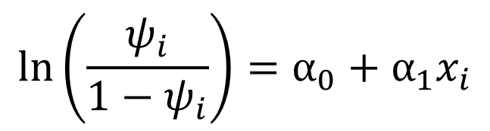
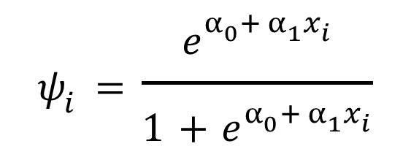
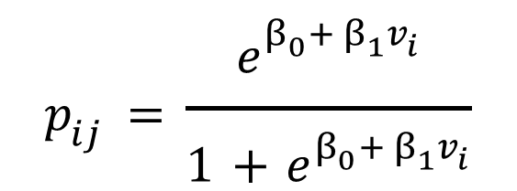
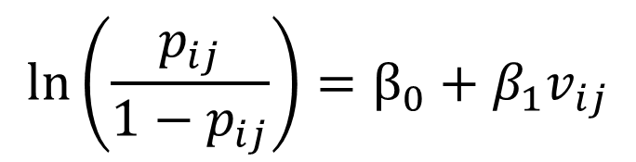
Single Season Model: Covariates
Occupancy and detection probabilities may be functions of abiotic and biotic covariates (via logit link)
$$ψ_{i}=\frac{e^{α_{0}+ α_{1}x_{i}}}{1+e^{α_{0}+ α_{1}x_{i}}}$$
$$p_{ij}=\frac{e^{β_{0}+ β_{1}v_{i}}}{1+e^{β_{0}+ β_{1}v_{i}}}$$
which is the inverse of:
$$\ln\left(\frac{ψ_{i}}{1−ψ_{i}}\right)=α_{0}+α_{1}x_{i}$$
$$\ln\left(\frac{p_{ij}}{1−p_{ij}}\right)=β_{0}+β_{1}v_{ij}$$

Slide 23
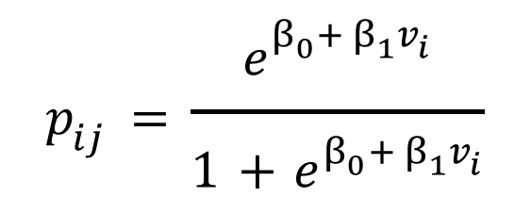
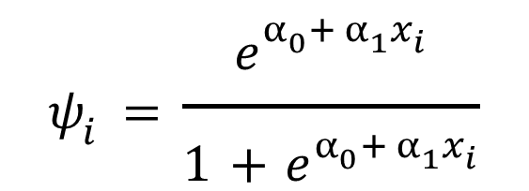
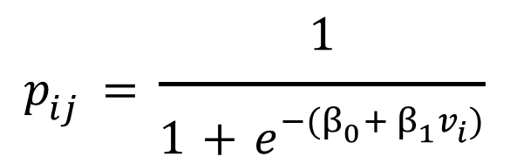
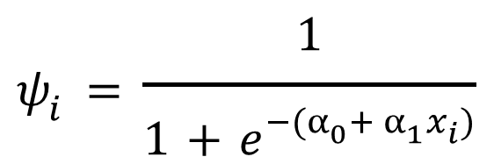
Single Season Model: Covariates
Occupancy and detection probabilities may be functions of abiotic and biotic covariates (via logit link)
$$ψ_{i}=\frac{e^{α_{0}+ α_{1}x_{i}}}{1+e^{α_{0}+ α_{1}x_{i}}}$$
$$p_{ij}=\frac{e^{β_{0}+ β_{1}v_{i}}}{1+e^{β_{0}+ β_{1}v_{i}}}$$
Recall: We can also back-transform like this,
$$ψ_{i}=\frac{1}{1+e^{−(α_{0}+ α_{1}x_{i})}}$$
$$p_{ij}=\frac{1}{1+e^{−(β_{0}+ β_{1}v_{i})}}$$

Slide 24
Single Season Model
‘Missing’ Observations
Implicit assumption that j^{th} survey of all units are conducted at (approximately) the same time; possibly unlikely in practice.
Weather or breakdowns may result in some units not being surveyed.
Equal sampling effort may not be possible with available resources.

Slide 25
Single Season Model
‘Missing’ Observations
 | Day
Unit | 1 | 2 | 3 | 4 | 5
1 | 1 | 0 | 1 | - | 0
2 | - | 0 | - | 1 | 1

Slide 26
Occupancy Models: Assumptions & Limitations
Sites are closed
species cannot enter or leave
Species are identified properly (no false positives)
but see Royle and Link (2006)
Surveys are independent
No un-modeled heterogeneity in occupancy/detection

Slide 27
Occupancy Models: Assumptions & Limitations
What if occupancy changes?
If species physically occupies units at random, ‘occupancy’ parameter relates to probability a unit is used by the species
Non-random changes may cause biases
Is a ‘season’ defined appropriately?

Slide 28
Occupancy Models: Assumptions & Limitations
Lack of Independence
Surveys are not independent if the outcome of survey A is dependent upon the outcome of survey B
Some forms of dependence may be accommodated with good designs or modeling (random effects)
In some instances, parameter estimates may be OK, but standard errors too small (biased low)

Slide 29
Occupancy Models: Extensions
Extensions of Occupancy Models
Multi-state
Multi-species
Multi-season (robust design)
Multi-season, multi-state
Occupancy & abundance
Many others…

Slide 30
Occupancy Models: Extensions
Extensions of Occupancy Models
Multi-state
Multi-species
Multi-season (robust design)
Multi-season, multi-state
Occupancy & abundance
Many others…

